Slide 1
Objective 4.3
Discuss the extent to which findings from a single case can be generalized

Slide 2
Generalizing from Case Studies
Case studies have been criticized for lacking the grounds for generalization
Yin (1994) argued that case studies are only “generalizable to theoretical propositions and not to populations”
Although inferential generalization can occur with carefully designed case studies.

Slide 3
Elements of a Single Case Study
A Case Study is known as a triangulated research strategy. This means that a single case can include triangulation with data, investigators, theories, and even methodologies.
Stake (1995) stated that the protocols that are used to ensure accuracy and alternative explanations make generalizability (to some extent) possible with a single case.
This occurs when proper procedures are followed to ensure trustworthiness of a single case.

Slide 4
Theoretical Generalization
Yin has explained that the purpose of case studies is in “analytical generalization” to expand theory and not in statistical generalization.
Thus, theory grows stronger with case studies and can potentially confirm previous bodies of literature.

Slide 5
Inferential Generalization
Hammersley (1992) argues that evidence from other studies that provide converging evidence to previous case studies allow some generalization to individuals similar to those used in the studies.
Thus, if we are studying a specific group or culture, we are able to apply the single case to similar groups.
This also depends on the rich-thick description of the case and the context.

Slide 6
Generalizing with caution: Not in all cases
The intrinsic case, as previously discussed, is often exploratory in nature, and the researcher is guided by his or her interest in the case itself rather than in extending theory or generalizing across cases.
In this type of case study, generalization is not the aim nor is it advised. The nature of a single intrinsic case do not design themselves to generalize theoretically or inferentially.

Slide 7
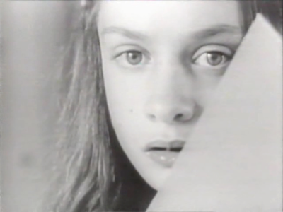
How can we generalize from The Case of Genie?

Slide 8
How we can generalize from a single case.
Trustwothy
Single Case
Deprivation can influence speech development in feral children
Theoretical Generalization
Critical period for language acquisition theory
Inferential Generalization
Environment influence on feral children

