Slide 1
The Biological Level of Analysis
Formal Lecture

Slide 2
Biological Level of analysis
At the most basic level of analysis, human beings are biological systems. It is the assumption that our mental processes, emotions and behaviors are products of the anatomy and physiology of our nervous and endocrine systems.

Slide 3
Biological Level of analysis
Over the last few centuries, discoveries have shown that:
The nature of the nervous system is electrical in part (Galvani)
Different areas of the brain carry out different functions (Broca)
Small gaps exist between nerve cells that require the action of chemicals to carry neural transmission across these gaps
Hormones play an important role in our psychological functioning.

Slide 4
Topics we will discuss in this level of analysis.
Principles/Research/Theories/Ethical considerations
Physiological and behavior
Genetics and behavior

Slide 5
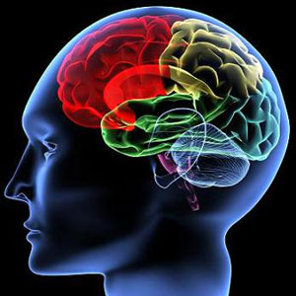
Objective 1&2
1. Outline principles that define the biological level of analysis.
2. Explain how principles that define the biological level of analysis may be used in research.

Slide 6
Important Note: Principles are any basic assumption that has been identified by research at this level of analysis
There are numerous assumptions that can be used for this objective.

Slide 7
Principle 1: Human behavior is localized to specific parts of the brain.
This means that anytime you are thinking, the brain is working.
In other words….everything psychological has a physiological origin.
This theory has been demonstrated in research by experiments, case studies, post mortem studies, etc., that look at specific areas of the brain and how they correlate to specific functions.

Slide 8
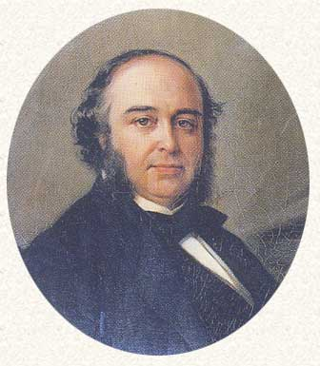
Principle 1: Human behavior is localized to specific parts of the brain.
An example of this theory in research is French Physician Pierre Paul Broca’s research on localization of function.

Slide 9
Dr. Pierre Paul Broca
Broca is most famous for his discovery of the speech production center of the brain located in the ventro-posterior region of the frontal lobes (now known as Broca's area).
He arrived at this discovery by studying the brains of aphasic patients.

Slide 10
Broca’s research
In 1861, through post-mortem autopsy, Broca determined that Tan (his patient nicknamed this because of his inability to clearly speak any words other than "tan“) had a lesion caused by syphilis in the left cerebral hemisphere.
This lesion was determined to cover the area of the brain important for speech production, affecting syntactic skills of patients. (Although history credits this discovery to Broca’s area to another French neurologist, Marc Dax, made similar observations a generation earlier.)

Slide 11
Broca’s research
From Broca’s research, we were able to isolate specific parts of the brain that are correlated with specific behaviors.
Thus, the principle that states “Human behavior is localized to specific parts of the brain” was demonstrated.

Slide 12
Principle 2: Animal research (because of the biological similarity) can enlighten our understanding of human behavior.
Research suggests that animals and human are similar biologically leading to similarities in behavior.
This principle perpetuates the first principle which assumes that behavior is biologically determined.
This theory can be demonstrated in research using animal models to study biological factors that influence behavior.
More info on
http://pages.uoregon.edu/adoption/studies/HarlowMLE.htm

Slide 13
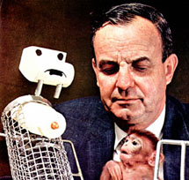
Principle 2: Animal research (because of the biological similarity) can enlighten our understanding of human behavior.
An example of this theory demonstrated in research is Psychologist Dr. Harry Harlow’s research with rhesus monkeys and attachment.
More info on
http://pages.uoregon.edu/adoption/studies/HarlowMLE.htm

Slide 14
Dr. Harry Harlow
The famous experiments that psychologist Harry Harlow conducted in the 1950s on maternal deprivation in rhesus monkeys were landmarks not only in primatology, but in the evolving science of attachment and loss.
More info on
http://pages.uoregon.edu/adoption/studies/HarlowMLE.htm

Slide 15
Dr. Harry Harlow
Harlow himself repeatedly compared his experimental subjects to children and press reports universally treated his findings as major statements about love and development in human beings.
These experiments had powerful implications for any and all separations of mothers and infants, including adoption, as well as childrearing in general.
More info on
http://pages.uoregon.edu/adoption/studies/HarlowMLE.htm

Slide 16
Dr. Harry Harlow
Although his experiments were socially significant as well, his research demonstrated principle 2 in that animal models were used to understand behavioral phenomena.
More info on
http://pages.uoregon.edu/adoption/studies/HarlowMLE.htm

Slide 17
Principle 3: Genetic predispositions may affect behavior and or mental processes.
Research suggests that many psychological disorders are a result of genetic predispositions.
This principle assumes that behaviors, in part, can be inherited and or the result of genetic mutations.
More info on
http://pni.med.jhu.edu/research/ad.htm

Slide 18
Principle 3: Genetic predispositions may affect behavior and or mental processes.
This theory can be demonstrated in research that looks at genetic causes of behavior and/or mental process.
Specifically, research that analyzes genetic mutations and variations in patients who suffer from cognitive disorders (i.e. Alzheimer's).
More info on
http://pni.med.jhu.edu/research/ad.htm

Slide 19
Principle 3: Genetic predispositions may affect behavior and or mental processes.
An example of this principle demonstrated in research is the current research being done at Boston University and the University of Arizona that look at gene variations and their correlation to decision making (Frank & Moreno 2011).
More info on
http://pni.med.jhu.edu/research/ad.htm

Slide 20
Principle 3: Genetic predispositions may affect behavior and or mental processes.
Researchers at Brown University and the University of Arizona have determined that variations of three different genes in the brain (called single-nucleotide polymorphisms) may help predict a person’s tendency to make certain choices.
This research suggests that mental processes, specifically, decision making can be predetermined by genes.
More info on
http://pni.med.jhu.edu/research/ad.htm

Slide 21
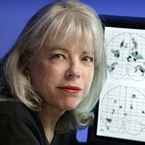
Familial Alzheimer's Diseased Research
The Familial Alzheimer's Disease Research Program, spearheaded by Dr. Susan Bassett, is a collection of studies aimed at understanding the genetic susceptibility to Alzheimer's disease and identifying risk factors in populations at risk.
The program also uses functional imaging and neuropsychological testing to investigate cognitive abnormalities in these populations.
More info on
http://pni.med.jhu.edu/research/ad.htm

Slide 22
Familial Alzheimer's Diseased Research
The Familial Alzheimer's Disease Research Program demonstrates that cognitive disorders such (such as Familial Alzheimer’s Disease) can be studied using physiological methods.
This principle also relates back to the first principle of this level of analysis.
More info on
http://pni.med.jhu.edu/research/ad.htm

Slide 23
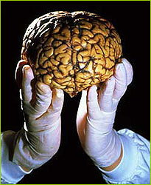
Objective 3
3. Discuss how and why particular research methods are used at the biological level of analysis.
4. Discuss Ethical Considerations Related to research studies at the Biological Level of analysis.

Slide 24
Research Methods
Research methods are categories of terminologies, strategies, and techniques that are used to conduct research.
Specific research methods are used at the specific levels of analyses in distinct ways.
It is important to note that the same research method can be used differently at each levels of analysis.

Slide 25
Research Methods
Things to consider……
The aim of research at the biological level of analysis is significantly different from research at the cognitive and socio-cultural level.
Examples: Research at the BLOA tend to focus on the study of physiological, genetic, and developmental mechanisms of behavior in human and non-human animals.

Slide 26
Research Methods
Five research methods at the Biological Level of analysis:
Animal Research
Post-Mortem studies
Case studies
Neuroimaging technologies

Slide 27
Animal research
Psychology encompasses a broad range of areas of research and applied endeavors. Important parts of these endeavors are teaching and research on the behavior of animals, which contribute to the understanding of basic principles underlying behavior and to advancing the welfare of both human and nonhuman animals.
Source:
American Psychological Association

Slide 28
Animal research
Why Use Animals in Research?
To understand the behavior of animals
To study evolutionary precursors of human capacities
To study questions that cannot be studied in people
Source:
American Psychological Association

Slide 29
Animal research
Extent of Animal Research
Most animals used in psychological research
are rats, mice, or monkeys
– APA estimates 7-8% of
research uses animals
– 90% of animal research uses rodents and birds
• APA has a Committee on Animal Research and Ethics (CARE)
Source:
American Psychological Association

Slide 30
Animal research
Main reason for Animal research
Studies Not Possible with People
Genetic manipulations (genetic manipulation of memory)
Behavioral genetics
Surgical manipulations
Split brain studies
Brain lesion studies
Traumatic interventions (Fear conditioning)
Source:
American Psychological Association

Slide 31
Animal research
Animal research is often an area that is debated yet the effects of using animal research in medicine, science, and psychology cannot be denied.
An example of a theory that has derived from animal research is Harry Harlow’s attachment theory.
Source:
American Psychological Association

Slide 32
Animal research
In a series of controversial experiments conducted in 1960s, Harlow demonstrated the powerful effects of love.
By showing the devastating effects of deprivation on young rhesus monkeys, Harlow revealed the importance of a mother's love for healthy childhood development.
His experiments were often unethical and shockingly cruel, yet they uncovered fundamental truths that have heavily influenced our understanding of child development.
More info:
http://www.animalresearch.info/en/home

Slide 33
Animal research
Harlow’s most famous experiment involved giving young rhesus monkeys a choice between two different "mothers."
One was made of soft terrycloth, but provided no food. The other was made of wire, but provided food from an attached baby bottle.
More info:
http://www.animalresearch.info/en/home

Slide 34
Animal research
Harlow removed young monkeys from their natural mothers a few hours after birth and left them to be "raised" by these mother surrogates.
The experiment demonstrated that the baby monkeys spent significantly more time with their cloth mother than with their wire mother.
"These data make it obvious that contact comfort is a variable of overwhelming importance in the development of affectionate response, whereas lactation is a variable of negligible importance," Harlow explained (1958).
More info:
http://www.animalresearch.info/en/home

Slide 35
Animal research
While many experts ridicule the importance of parental love and affection, Harlow’s experiments offered irrefutable proof that love is vital for normal childhood development.
Additional experiments by Harlow revealed the long-term devastation caused by deprivation, leading to profound psychological and emotional distress and even death.
More info:
http://www.animalresearch.info/en/home

Slide 36
Animal research
Harlow’s work, as well as important research by psychologists Mary Ainsworth, helped influence key changes in how orphanages, adoption agencies, social services groups and child care providers approached the care of children.
Thus, we see the importance that animal research has on humans because of their biological similarities.
More info:
http://www.animalresearch.info/en/home

Slide 37
Why conduct animal research?
Supporters of the use of animals in experiments, such as the British Royal Society, argue that virtually every medical achievement in the 20th century relied on the use of animals in some way
The Institute for Laboratory Animal Research of the U.S. National Academy of Sciences argues that even sophisticated computers are unable to model interactions between molecules, cells, tissues, organs, organisms, and the environment, making animal research necessary in many areas.
More info:
http://www.animalresearch.info/en/home

Slide 38
Post Mortem Studies
Postmortem studies are a neurobiological research method in which the brain of a patient, usually the subject of a longitudinal study, with some sort of phenomenological affliction (i.e. cannot speak, trouble moving left side of body, Alzheimer’s, etc.) is examined after death.
The irregularities, damage, or other cerebral anomalies observed in the brain are attributed with whatever ailment the patient was afflicted with in life. With repeated studies a more exact correlation can be ascertained.

Slide 39
Post Mortem Studies
Because of the assumption that human behavior is localized to specific parts of the brain, we can look at specific lesions and correlate them to specific behaviors/disorders.
Postmortem studies have been used to further the understanding of the brain for centuries. Before the time of the MRI, CAT Scan, or X-ray it was one of the few ways to study the relationship between behavior and the brain.
What is an example of one post mortem study that has been used at the Biological Level of Analysis?

Slide 40
Post Mortem Studies
Paul Broca used postmortem studies to link a specific area of the brain with speech production.
The research of Broca, through post mortem studies, led to further post mortem research on language from Karl Wernicke and others.

Slide 41
Post Mortem Studies
Postmortem research, which allows scientists to study the brain directly via its tissue, is difficult and expensive.
Hence, it is a relatively rare avenue of research into brain disorders.
Instead, such research more often focuses on studying the brain indirectly by using specialized imaging techniques, animal models, or blood markers.

Slide 42
Post Mortem Studies
Advances in science and specialized techniques over recent years have also expanded the scope of the work that can be accomplished using postmortem brain tissue.
In addition to structural distinctions, cellular, molecular, and genetic findings can be identified using a postmortem research approach.

Slide 43
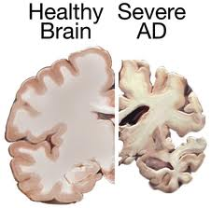
Post Mortem Studies
Postmortem studies of the brain have already contributed to our understanding of diseases such as schizophrenia, and amnesia and will continue to do so.
For example, critical work has already shown how brains from people with Alzheimer's differ in terms of structure and function, and how the genes which contribute to causing these illnesses affect the brain.

Slide 44
Objective 4
Discuss ethical considerations related to research studies at the biological level of analysis.
Remember, the command term is discuss (not outline or list).
Thus, the command term requires a deeper understanding of the objective.

Slide 45
First things first, what are ethical considerations? This should be discussed in your essay.

Slide 46
General Ethical Considerations
Ethics are codes or rules which govern that practices of a research study.
It dictates how information, and participant relationships should be managed. Code of ethics and the laws are mutually exclusive.
An action may be legal but unethical. However some acts are both illegal and unethical.
Ethical considerations occur when you are required to use these rules to better serve your participant in your research study.

Slide 47
Biological Research Ethical Topics
Human research/Post Mortem Studies
Animal research

Slide 48
General Ethical Considerations
In dealing with human subjects, American psychologists follow a code of ethical principles published by the American Psychological Association, which requires investigators to obtain informed consent from all subjects protect subjects from harm and discomfort treat all experimental data confidentially explain the experiment and the results to the subjects afterward.

Slide 49
All researchers are responsible for ensuring that participants
Are well-informed about the purpose of the research they are being asked to participate in
Understand the risks they may face as a result of being part of the research
Understand the benefits that might accrue to them as a result of participating
Feel free to make an independent decision without fear of negative consequences

Slide 50
Ethical considerations of human research
Basic Principles
1. Biomedical research involving human subjects must conform to generally accepted scientific principles and should be based on adequately performed laboratory and animal experimentation and on a thorough knowledge of the scientific literature.

Slide 51
Ethical considerations of human research
Basic Principles
2. Biomedical research involving human subjects cannot legitimately be carried out unless the importance of the objective is in proportion to the inherent risk to the subject.

Slide 52
Ethical considerations of human research
Basic Principles
3. The right of the research subject to safeguard his or her integrity must always be respected. Every precaution should be taken to respect the privacy of the subject and to minimize the impact of the study on the subject's physical and mental integrity and on the personality of the subject.
For more info
http://www.iospress.nl/authco/bir/bir_ethical_considerations.pdf

Slide 53
Ethical considerations of postmortem studies
A significant change in the treatment of the recently dead occurred when the National Health Service was born in 1948, marking a significant change of attitude in care taken for postmortem studies.
For the first time in Western history, there evolved equilibrium between the number of bodies freely available and the number required for teaching and research.
Bodies for donation, teaching and research were provided in a spirit of trust and generosity, by voluntary public donation, motivated by altruism.

Slide 54
Ethical considerations of postmortem studies
From 1961 and the establishment of Human Tissue Act (HTA), organs, tissues, and body parts—obtained from post-mortem examinations—required a consent procedure; the HTA obligates clinicians to enquire whether any surviving relatives of a deceased person might object to the body being used for therapeutic purposes, medical education, or research.

Slide 55
Ethical considerations of post mortem studies
Strict requirements of informed consent tend to inhibit medical research conduct, in particular research on the post-mortem brain, which is one of the important research areas for clarification of pathogenesis and pathophysiology of mental disorders.

Slide 56
Confidentiality of Medical Information Postmortem
All medically related confidences disclosed by a patient to a physician and information contained within a deceased patient’s medical record, including information entered postmortem, should be kept confidential to the greatest possible degree.
However, the obligation to safeguard patient confidences is subject to certain exceptions that are ethically and legally justifiable because of overriding societal considerations.

Slide 57
Confidentiality of Medical Information Postmortem
At their strongest, confidentiality protections after death would be equal to those in force during a patient’s life. Thus, if information about a patient may be ethically disclosed during life, it likewise may be disclosed after the patient has died.

Slide 58
Confidentiality of Medical Information Postmortem
Disclosure of medical information postmortem for research and educational purposes is appropriate as long as confidentiality is maintained to the greatest possible degree by removing any individual identifiers.
As in the case with Dr. Broca’s patient “Tan”, whose personal identification was kept confidential.

Slide 59
Animal Research
Using animals in research affords the scientist to monitor reactions to stimuli and other variables in complex organs and tissue, while allowing the scientist to minimize environmental variables.
Animals are used in scientific research to further science in many arenas. They are used most often in the following cases:
Disease Treatment /Prevention
Correlates between brain lesions and behavior
Basic Medical Drug Testing
Medical Diagnosis

Slide 60
Why use animals?
The following guidelines were developed by the American Psychological Association (APA) for use by psychologists working with nonhuman animals.
I. Justification of the Research
II. Personnel
III. Care and Housing of Animals
IV. Acquisition of Animals
V. Experimental Procedures

Slide 61
Ethical considerations of animal research
Animals should be used only if the scientific objectives are valid, there is no other alternative, and pain and suffering are kept to a minimum.
The research should have a high probability of meeting the stated objectives, and these objectives should have a reasonable chance of contributing to human or animal welfare, possibly in the long term.
Research should also conform with any National standards (such as APA in the United States) relating to the use of animals in biomedical research, and such conformity should be noted.
For more info http://www.nc3rs.org.uk/

Slide 62
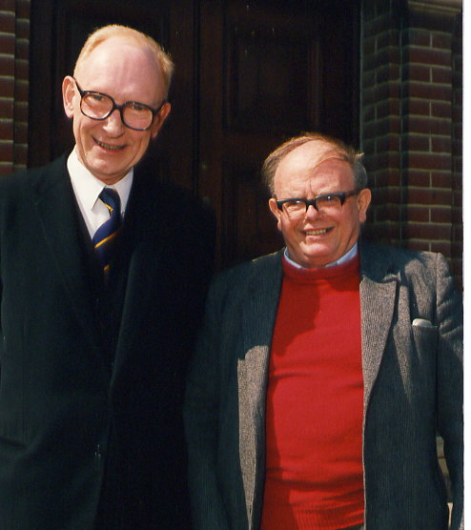
Ethical considerations of animal research
Two British scientists, Bill Russell and Rex Burch introduced the “3Rs” as a framework for considering the humane use of animals.
Replacement
Refinement
Reduction

Slide 63
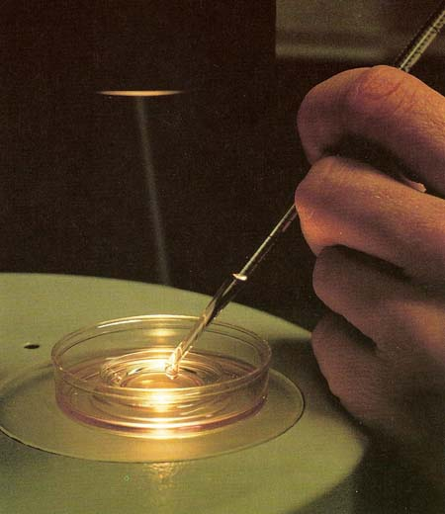
Replacement
Animals should be replaced in experiments by less sentient alternatives such as invertebrates or in vitro methods whenever possible.

Slide 64
Refinement
If animal experiments can not be avoided protocols should be refined to minimize any adverse effects for each individual animal.
Appropriate anesthesia and numbing should be used for any surgical intervention. Humane endpoints should be used whenever possible.
Staff should be well trained, and housing should be of a high standard with appropriate environmental enrichment. Animals should be protected from pathogens.

Slide 65
Reduction
The number of animals should be reduced to the minimum consistent with achieving the scientific objectives of the study, recognizing that important biological effects may be missed if too few animals are used.
Alternatively, methods should be found to obtain more information from each experiment, thus speeding up the pace of research. This can be achieved by careful control of variation and by appropriate experimental design and statistical analysis.

Slide 66
Questions regarding 1.4?

Slide 67
Ethical considerations of genetic and research
Genetic information is often considered "special," or different from other kinds of medical information because of its close association with individual identity, which is due in part to the common assumption that genes are determinative of human health and behavior.

Slide 68
Ethical considerations of genetic research
This assumption creates opportunities for social stigma and discrimination by employers and insurers.
In addition, the fact that genetic information about an individual reveals information about relatives creates new and complex ethical issues, particularly regarding privacy and confidentiality (MacKay, 1993)

Slide 69
Ethical considerations of genetic engineering
Genetic information is in most cases probabilistic, providing information about risks, not definitive diagnoses.
The interpretation of genetic risks is a complex process, influenced by numerous factors.
For this reason, it is generally agreed that when research involves disclosure of genetic information to subjects, such disclosure should always be accompanied by genetic counseling.

Slide 70
Genetic engineering ethical considerations
1. Description of study
• How a disease is selected for study
• Therapeutic goal of study
• Available alternative therapies
• How DNA will be transferred, and where

Slide 71
Genetic engineering ethical considerations
2. Research design, risks, and benefits
• Description of methods and materials
• Pre-clinical studies, including evidence of safety and effectiveness
• Treatment method and means of monitoring effects
• Medical risks to subject
• Qualifications of investigator and clinical facilities

Slide 72
Genetic engineering ethical considerations
3. Means of subject selection
• Eligibility criteria
• Numbers of subjects
• Recruitment procedures

Slide 73
Genetic engineering ethical considerations
3. Informed consent—additional issues
• Potential adverse medical effects
• Cost issues
• Possible media attention
• Irreversibility of treatment

Slide 74
Ethical considerations of genetic and neuropsychology
To what extent should we allow genetic engineering?
Should genetic engineering research be treated as “pro-choice” with abortion? Why or why not?

Slide 75
Genetic Engineering
We are fast approaching arguably the most consequential technological threshold in all of human history: the ability to alter the genes we pass to our children.
Human genetic engineering is the alteration of an individual's genotype with the aim of choosing the phenotype of a newborn or changing the existing phenotype of a child or adult

Slide 76
Genetic Engineering
It holds the promise of curing genetic diseases like cystic fibrosis, and increasing the immunity of people to viruses.
It is speculated that genetic engineering could be used to change physical appearance, metabolism, and even improve mental faculties like memory and intelligence, although for now these uses seem to be of lower priority to researchers and are therefore limited to science fiction.

Slide 77
Brief history of Genetic Engineering
In 1976, the first successful genetic manipulation took place on mice, in efforts to produce more accurate disease models and test subjects.
These mice were modified at the germline stage: that is, permanent genetic changes were induced by transplanting new genes into the mouse’s embryo.
A+ info on Genetic Engineering
http://web.mit.edu/murj/www/v12/v12-Features/v12-f4.pdf

Slide 78
Brief history of Genetic Engineering
The real breakthrough happened twenty five years later—on January 11, 2001, when scientists in Oregon unveiled ANDi, a baby rhesus monkey carrying a new jellyfish gene in his genome.
It wasn't until the year 2003 when the first human genome was modified by scientist Jacques Cohen. Cohen had produced two healthy babies from the genetics of two different mothers in his attempt to solve infertility issues.

Slide 79
Brief history of Genetic Engineering
This technology uses the pre-genetic implantation(PGD), a form of in vitro fertilization(IVF).
In addition to that, the created embryos are then screened to see if there are any faulty genetics before implantation.
After the embryos have matured to an 8-cell stage, one or two embryos are then tested to see if there are any faulty genes. The one without fault is then implanted into the mother.

Slide 80
Brief history of Genetic Engineering
The pre-implantation process can be used to eliminate illness and defect.
One prime example is Adam Nash. He was the first child to be born using this technology to save his dying sister of Faconi's anaemia (a genetic disease that can cause a predisposition for cancer) by becoming a donor. This technology can also be used to prevent Down's Syndrome (Trisomy 21).
Similar principles of this technology are used to alter crops and plants to resist herbicides and pesticides.

Slide 81
Brief history of Genetic Engineering
Geneticist have altered the IQ of mice by placing an extra gene, NR2B, which plays a major role in the brain. The mice that had the extra copy of the gene learned faster and retained memory longer than normal mice.
Hobbie-J is a transgenically-enhanced rat able to remember novel objects for three times longer than the average Long Evans female rat (the smartest rat strain).

Slide 82
Brief history of Genetic Engineering
Researchers from the Medical College of Georgia and East China Normal University developed Hobbie-J 's superior brainpower by transgenic over-expression of the NR2B gene, which in turn increased communication between NMDA receptor sites maybe a hundred milliseconds longer than normal, just enough to enhance learning and memory.
NMDA receptors (and their NR2B subunits) are the controlling molecular structures for synaptic plasticity and memory.
A+ info on Hobbie-J
http://www.sciencedaily.com/releases/2009/10/091019122647.htm

Slide 83
Genetic engineering discussions:
http://fora.tv/2007/07/01/Debating_Matters_Human_Genetic_Engineering#fullprogram
http://www.youtube.com/watch?v=hTZnVnAWOjY
A+ info on genetic engineering
http://www.neuroethics.upenn.edu/index.php/penn-neuroethics-briefing/overview-of-neuroethics

