Slide 1
Health Psychology
Spring 2013

Slide 2
Objective 2.2 (EQ):
Discuss physiological, psychological and social aspects of stress

Slide 3
Prologue Notes:
Define Stress (to assist you in developing your essay)
It is your aim to present stress as a biopsychosocial reaction (Thus, dependent upon all three aspects)
Provide examples of all three aspects of stress.
Be prepared to evaluate any research that is presented

Slide 4
Terms you have to know:
Stress/Stressor
Fight or Flight Response
General Adapative Syndrome
Epinephrine and Glucortocoid
Cognitive Appraisal Theory of Stress
Buffering Hypothesis

Slide 5
Review of Stress
Stress: A psychological and physical response of the body that occurs whenever we must adapt to changing conditions, whether those conditions be real or perceived, positive or negative.
Although everyone has stress in their lives, people respond to stress in different ways culturally. Some people seem to be severely affected while others seem calm, cool, and collected all the time.
By definition, stress appears to have biological, cognitive, and sociocultural components.

Slide 6
Biopsychsocial aspects of Stress
As previously stated, the term stress refers both to the physiological and psychological changes that occur when a stressor is present, and to the symptoms we consequently develop. Our cognitions (schemas, attention, etc.) shape our perception of stress, however, our bodies tell us when we feel stress.
Moreover, our culture gives us a tolerance and a vulnerability to certain stressors (i.e., IB culture).
Psychological research has supported the assumption that stress has various aspects.

Slide 7
Biological aspects of Stress
There are several physiological responses that are reliably correlated with the experience of stress and with stressful physical stimuli.
This repertoire of responses plays an important role in preparing individuals to cope with assumed internal or external stimuli that might threaten their well being or survival.
Threats to homeostasis are met by acute physiological responses that are quick and engage our biological systems.

Slide 8
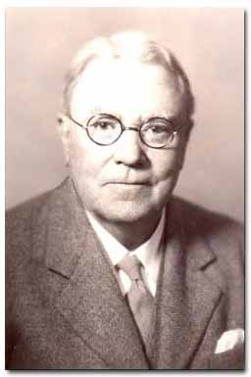
Biological aspects of Stress
Change in Body Chemistry: The Fight or Flight Response:
When we experience excessive stress—whether from internal worry or external circumstance—a bodily reaction is triggered, called the "fight or flight" response.
Originally discovered by the great Harvard physiologist Walter Cannon, this response is hard-wired into our brains and represents a genetic wisdom designed to protect us from bodily harm

Slide 9
Biological aspects of Stress
What is fight or flight response?
This fundamental physiological response forms the foundation of modern day stress medicine.
The "fight or flight response" is our body's primitive, automatic, inborn response that prepares the body to "fight" or "flee" from perceived attack, harm or threat to our survival.

Slide 10
Biological aspects of Stress
The Physical aspect of stress:
When our fight or flight response is activated, sequences of nerve cell firing occur and chemicals like adrenaline, noradrenaline and cortisol are released into our bloodstream.
These patterns of nerve cell firing and chemical release cause our body to undergo a series of very dramatic changes.

Slide 11
Biological aspects of Stress
The Physical aspect of stress:
Our respiratory rate increases.
Blood is pushed away from our digestive tract and directed into our muscles and limbs, which require extra energy and fuel for running and fighting.
Our pupils dilate. Our awareness intensifies. Our sight sharpens. Our impulses quicken. Our perception of pain diminishes.

Slide 12
Biological aspects of Stress
The Physical aspect of stress:
The steroid hormones reduce activity in parts of the immune system, so that specific infection fighters (including important white blood cells) or other immune molecules can be repositioned. This leaves the immune system vulnerable to infection. We become prepared—physically and psychologically—for a oncoming stressor.

Slide 13
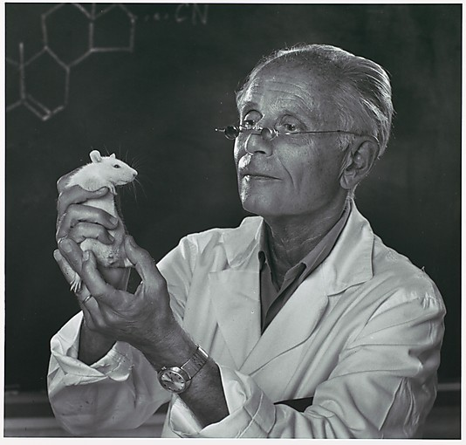
Biological aspects of Stress
Selye’s research
Hans Selye based his theory on research with rats, which all showed the same general symptoms when they were exposed to different stressors.
Things to consider….
What would be the limitations to applying a biological model using animals?

Slide 14
Biological aspects of Stress
General Adaptive Syndrome
Selye - 'the father of stress research,' introduced the General Adaptation Syndrome model in 1936 showing in three phases what the alleged effects of stress has on the body.
The three phases ARE: Alarm (A), Resistance (R), Exhaustion (E).

Slide 15
Biological aspects of Stress
Alarm Stage-
Your first reaction to stress recognizes there’s a danger and prepares to deal with the threat, a.k.a. the fight or flight response. During this phase the main stress hormones cortisol, adrenaline, and noradrenaline, are released to provide instant energy.
Resistance Stage -
This stage involves coping with the stress in an attempt to return to homeostasis. It also tries to reverse the effects of the alarm stage.

Slide 16
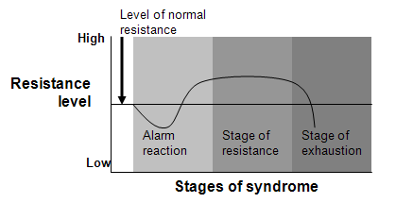
Biological aspects of Stress
Exhaustion Stage-
At this phase, the stress has continued for some time. Your body’s ability to resist is lost because its adaptation energy supply is gone.
Often referred to as overload, burnout, adrenal fatigue, maladaptation or dysfunction.

Slide 17
Biological aspects of Stress
Although our bodies biologically respond to a stressor with chemical reaction, perception plays a key role in our bodies ability to distinguish between good stress and bad stress.
Thus, cognition is a vital to our identification, assessment and coping abilities to stress…

Slide 18
Cognitive aspects of Stress
Mental processes (emotions, schemas, attention, perception, etc.) play a significant role in our appraisal of stressors. It is the cognitive appraisals that distinguish eustressors from distressors and inform us on the amount of control that we have on our stressful situations.
For example, research suggest that people who have pessimistic expectations about terminal illnesses tend to die quicker than their optimistic counterparts.

Slide 19
Cognitive aspects of Stress
“Psychological stress refers to a relationship with the environment that the person appraises as significant for his or her well being and in which the demands tax or exceed available coping resources” (Lazarus and Folkman 1986, p. 63).
This definition points to two processes as central mediators within the person–environment transaction: cognitive appraisal and coping.

Slide 20
Cognitive aspects of Stress
The model "theory of cognitive appraisal" was proposed by Lazarus and Folkman in 1984 and it explained the mental process which influence of the stressors.
According to Lazarus and Folkman, stress has a cognitive aspect in the form of appraising the stressor and determining the significance and relevance to the self.

Slide 21
Cognitive aspects of Stress
This concept is based on the idea that emotional processes (including stress) are dependent on schemas that persons manifest with regard to the significance and outcome of a specific encounter.
In other words, our experiences give us a storage unit of stressors that negatively impact us.
This concept is necessary to explain individual differences in quality, intensity, and duration of an elicited stress response in environments that are objectively equal for different individuals.

Slide 22
Cognitive aspects of Stress
Specifically, he identified two essential factors in an essay in which he discusses the cognitive aspects of stress: “first, what is the nature of the stressor (or appraisals) which underlie separate emotional reactions (e.g. fear, guilt, grief, joy, etc.). Appraisal is the determining factor in making sense of the physiological response we feel (it is the difference from a perceived eustress and distress)
Second, what are the determining antecedent conditions of these stressors (how do we perceive that we will cope with the stressor).

Slide 23
Cognitive aspects of Stress
The findings suggest that negative appraisals (i.e. threat, harmful) are associated with negative psychological and physical adjustment to stressors, whereas positive appraisals (i.e. challenges) are associated with positive psychological and physical adjustment. Examples can be explained and discussed.

Slide 24
Cognitive aspects of Stress
Further research has suggested that appraisal can be the difference between a negative and positive outlook on a stressor.
Recently, this appraisal model has been applied to a number of populations, including individuals with HIV/AIDS, cancer, obesity, and other psychological disorders.

Slide 25
Social aspects of Stress
The final and most vital component of stress is the actual exposure to the stressor.
Thus, environmental factors and stressor exposure play a key role in constructing our cognitive appraisals, and coping abilities to stress

Slide 26
Social aspects of Stress
External stressors (social factors) are the sources of stress that we are aware of around us.
These stressors are things that create a situation of perceived threat in our minds and bodies. Over the last few years many research studies has been done on external stressors.
Chronic exposure to external stressors or a highly stressful culture can negatively influences our physiological response to stress, our mental and physical health, and our cognitive appraisal of stressful situations.

Slide 27
Culture and Stress
External stressors (social factors) are the sources of stress that we are aware of around us.
These stressors are things that create a situation of perceived threat in our minds and bodies. Over the last few years many research studies has been done on external stressors.
Chronic exposure to external stressors or a highly stressful culture can negatively influences our physiological response to stress, our mental and physical health, and our cognitive appraisal of stressful situations.

Slide 28
Discussion
What are examples of chronic stressors?

Slide 29
Exposure to Stress
The following are some social causes of chronic stress:
A current ongoing situation (domestic violence)
An unresolved event or situation from the past (reliving past situations)
A traumatic event that took some time to deal with
Lingering feelings from a past event

Slide 30
Exposure to Stress
Research has shown that long-term exposure to stressful environments in mice can lead to prolonged production of stress hormones which result in the physiological symptoms of depression.
Paul Ardayfio, PhD candidate, and Kwang-Soo Kim, PhD, made their discovery by exposing mice to both short-term and long-term durations of stress, which in rodents is corticosterone.
In humans, usually ongoing, chronic stress has been associated with depression.

Slide 31
Social support and coping with stress
Social support, defined as both structural characteristics of a social network and perceived availability of resources, has been conceptualized as influencing the relationship between stress and depression.
A social support network can be made up of friends, family and peers. Research has shown that these social support groups can act as mediators when we are faced with stressors.

Slide 32
Social support and coping with stress
Social support, defined as both structural characteristics of a social network and perceived availability of resources, has been conceptualized as influencing the relationship between stress and depression.
A social support network can be made up of friends, family and peers. Research has shown that these social support groups can act as a buffer when we are faced with stressors. This has led to a theoretical term coined the “buffering hypothesis”.

Slide 33
Social support and coping with stress
In the buffering hypothesis, social support protects (or "buffers") people from the bad effects of stressful life events (e.g., death of a spouse, job loss).
Evidence for stress buffering is found when the correlation between stressful events and poor health is weaker for people with high social support than for people with low social support.

Slide 34
Social support and coping with stress
The weak correlation between stress and health for people with high social support is often interpreted to mean that social support has protected people from stress.
In what ways can our social support help us through stress?

Slide 35
Social support and coping with stress
A study by Brownand Harris (2005) provides an example of recent research addressing the buffering hypothesis.
The study investigated the role of social support in moderating the relationship between life change stress and psychiatric disorder in a large sample of l8-65-year-old women.

Slide 36
Social support and coping with stress
Women reporting that their husband or boyfriend was a conﬁdant-a person with whom she could talk about things that were troubling her-were considered to have high levels of support.

Slide 37
Social support and coping with stress
Those not reporting such a tie were considered to have low levels of support consistent with the buffering hypothesis.
Women who had experienced a severe life event and had low levels of support showed a substantial increase in their degree of psychiatric disturbance compared to nonstressed women.
While women who had experienced a severe life event but had high levels of support did not show increased pathology.

Slide 38
Conclusion
Things to consider:
What does social research suggest about stress and stressors?
Should there be cultural differences in perceptions of social support?
What are the limitations to only taking ONE approach to stress?

